Slide 1




The importance of sleep in learning

Slide 2

Problems with lack of sleep

Slide 3
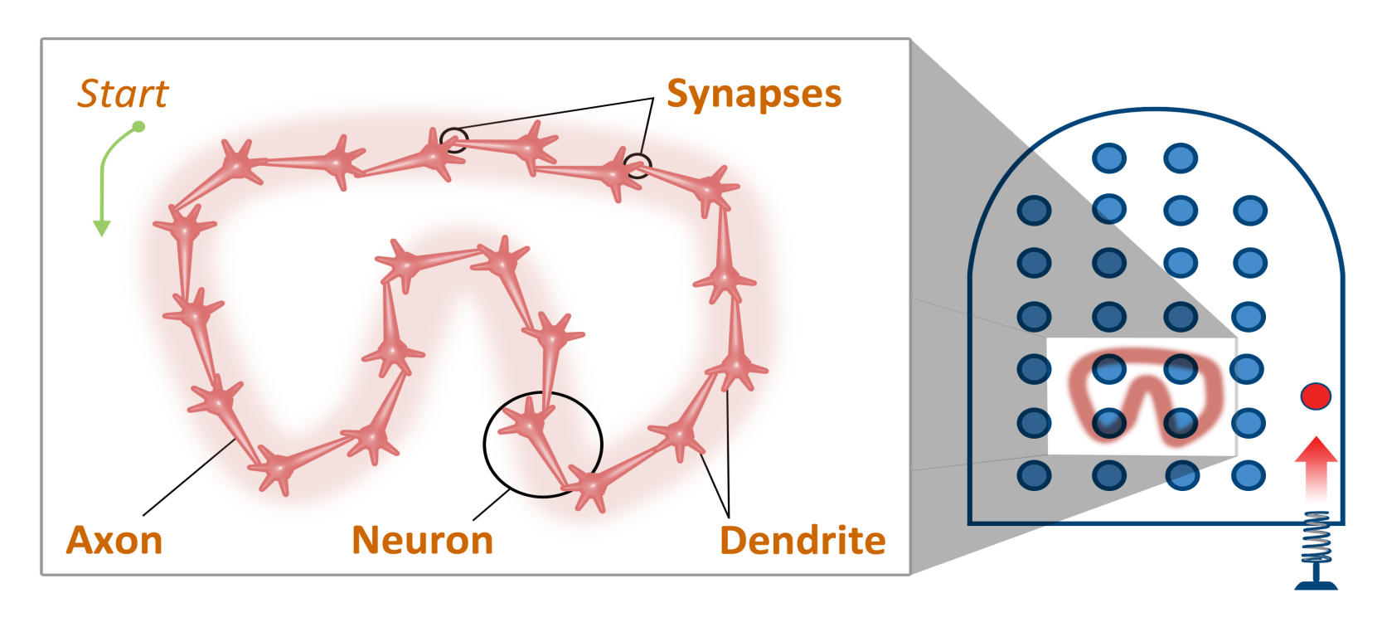

Slide 4
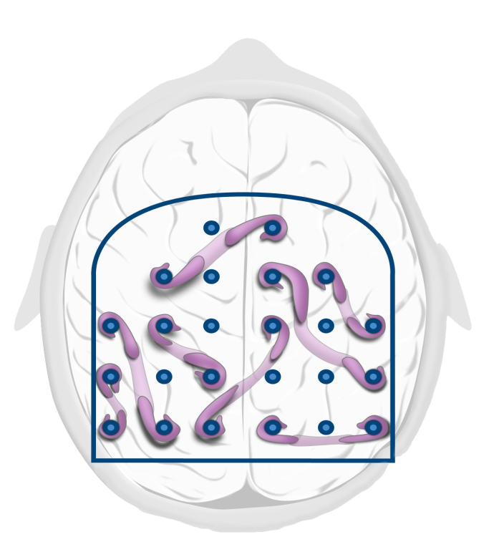


Slide 5
Relevant Readings
Djonlagic, I., A. Rosenfeld, D. Shohamy, C. Myers, M. Gluck, and R. Stickgold. "Sleep Enhances Category Learning." Learning & Memory 16, no. 12 (Dec 2009): 751-5.
Durrant, S. J., S. A. Cairney, and P. A. Lewis. "Overnight Consolidation Aids the Transfer of Statistical Knowledge from the Medial Temporal Lobe to the Striatum." Cerebral Cortex (Aug 14 2012).
Eichenbaum, H. "To Sleep, Perchance to Integrate." PNAS, 104, no. 18 (May 1 2007): 7317-8.
Ellenbogen, J.M., P.T. Hu, J.D. Payne, D. Titone, and M.P. Walker. "Human Relational Memory Requires Time and Sleep." PNAS, 104, no. 18 (2007): 7723-28.
Erlacher, Daniel, and Michael Schredl. "Practicing a Motor Task in a Lucid Dream Enhances Subsequent Performance: A Pilot Study." The Sport Psychologist, 24, no. 2 (2010): 157-67.
Moss, R. The Secret History of Dreaming. Novato, CA: New World Library, 2008.
Scullin, M. K., and M. A. McDaniel. "Remembering to Execute a Goal: Sleep on It!" Psychological Science 21, no. 7 (Jul 2010): 1028-35.
Stickgold, Robert, and Jeffrey M Ellenbogen. "Quiet! Sleeping Brain at Work." Scientific American Mind 19, no. 4 (2008): 22-29.
Wamsley, Erin J., Matthew Tucker, Jessica D. Payne, Joseph A. Benavides, and Robert Stickgold. "Dreaming of a Learning Task Is Associated with Enhanced Sleep-Dependent Memory Consolidation." Current Biology, 20, no. 9 (2010): 850-55.
Xie, Lulu, Hongyi Kang, Qiwu Xu, Michael J Chen, Yonghong Liao, Meenakshisundaram Thiyagarajan, John O’Donnell, et al. "Sleep Drives Metabolite Clearance from the Adult Brain." Science, 342, no. 6156 (2013): 373-77.
Image Credits
Brain during sleep animation © 2014 Kevin Mendez
Neural patterns with enlargement © 2014 Kevin Mendez
Random neural patterns © 2014 Kevin Mendez
Clip art courtesy Microsoft Corporation

